Slide 1
Hybrid Recommender systems
Notes:
More in the IR tradition

Slide 2
Hybrid Methods
Try to address the shortcomings of both content-based and collaborative-based approaches, and produce recommendations using a combination of those techniques
There is a large variability on these hybrid methods – there is no standard hybrid method
We shall present some of them here but many will come later
More in general, hybrid methods could be devised by combining two (or more) elementary methods: ex. Utility+Demographic.

Slide 3
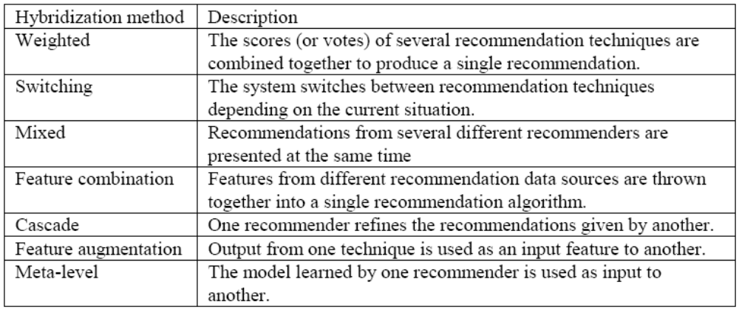
Hybridization Methods
[Burke, 2002]

Slide 4
Hybrid methods-weighted
A hybrid method can be defined as a way to integrate two or more product scores produced by two independent recommendation algorithms
S_{A}(p) is the predicted rating for product p computed by algorithm A
S_{B}(p) is the predicted rating for product p computed by algorithm B
S_{H}(p) = aS_{A}(p) + (1-a)S_{B}(p) hybrid rating (weighted).

Slide 5
Weighted Ranking
Product | Rank for Score1 | Score1 | Score2 | Rank for Score2 | alpha | beta | Compound score | Hybrid Rank
 |  |  |  |  | 0,4 | 0,6
a | 1 | 0,9 | 0,5 | 6 |  |  | 0,66 | 2
b | 2 | 0,7 | 0,6 | 4 |  |  | 0,64 | 3
c | 3 | 0,65 | 0,95 | 1 |  |  | 0,83 | 1
d | 4 | 0,6 | 0,58 | 5 |  |  | 0,59 | 4
f | 5 | 0,4 | 0,46 | 7 |  |  | 0,44 | 6
g | 6 | 0,2 | 0,3 | 8 |  |  | 0,26 | 8
h | 7 | 0,1 | 0,88 | 2 |  |  | 0,57 | 5
i | 8 | 0,04 | 0,1 | 10 |  |  | 0,08 | 10
l | 9 | 0,03 | 0,66 | 3 |  |  | 0,41 | 7
m | 10 | 0,02 | 0,23 | 9 |  |  | 0,15 | 9
Compound Score = α * Score1 + β * Score2

Slide 6
Weighted
The score of a recommended item is computed from the results of all of the available recommendation techniques present in the system
  Example 1: a linear combination of recommendation scores
  Example 2 – many recommender systems: treats the output of each recommender (collaborative, content-based and demographic) as a set of votes, which are then combined in a consensus scheme
The implicit assumption in this technique is that the relative value of the different techniques is more or less uniform across the space of possible items
Not true in general: e.g. a collaborative recommender will be weaker for those items with a small number of raters.

Slide 7
Weighted Example
Movie recommendations that integrates item-to-item collaborative filtering and information retrieval [Park et al., 2006]
Information retrieval component: Web(i, q)= (N+1-k(i))/N where N are the items returned by the query q and k(i) is the position of movie i in the results set (example q = “arnold swarzenegger”)
  Movies highly ranked by the IR component (low k(i)) have a Web(i,q) value close to 1
Item-to-item collaborative filtering: Auth(i, u) is the score of item i for user u
  Movies similar to those highly ranked by the user in the past get a high Auth(i, u) score
Final rank: MADRank(i,q,u)= a Auth(i,u) +(1-a)Web(i,q)
If Auth(i,u) cannot be computed (not enough ratings for u or i) then Auth(I,u) can be a non personalized score (e.g. item popularity) or simply not used (also some switching!)

Slide 8
Switching
The system uses some criterion to switch between recommendation techniques
Example: The DailyLearner [Billsus and Pazzani, 2000] system uses a content/collaborative hybrid in which a content-based recommendation method is employed first
If the content-based system cannot make a recommendation with sufficient confidence (how?), then a collaborative recommendation is attempted
  We need a method to measure the confidence of a prediction
This switching hybrid does not completely avoid the ramp-up problem, since both the collaborative and the content-based systems have the “new user” problem
The main problem of this technique is to identify a GOOD switching condition.

Slide 9
Mixed
Recommendations from more than one technique are presented together
The mixed hybrid avoids the “new item” start-up problem:
  since the content-based approach can be used for new items
It does not get around the “new user” start-up problem:
  both the content and collaborative methods need some data about user preferences to start up
But it is a good idea for hybridizing two different kind of recommender (e.g. demographic and collaborative)
It introduces DIVERSITY in the recommendation list.

Slide 10
Fab System- mixed approach
The user profile is based on content analysis (the tf-idf average of the documents liked by the user)
Two user profiles are compared to determine similar users
Then a collaborative based recommendation is generated
User receives items both when they score highly against their own profile and when rated highly by a user with a similar profile
[Balabanovich and Shoam, 1997]

Slide 11
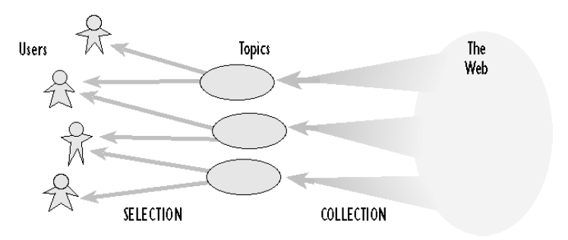
Selection of Relevant Pages
Pages relevant to specific topics are collected from the Web
Selections (recommendations) for individual users are made among these pages.

Slide 12
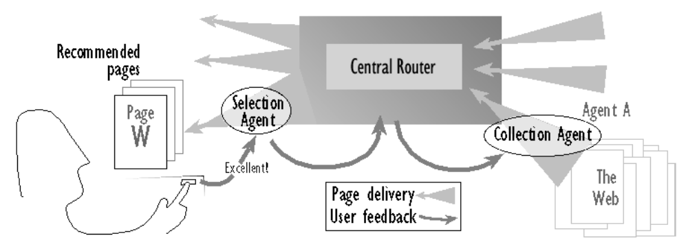
Fab Architecture
Collection agents: find pages relevant for a specific topic
Selection agent: find pages for a specific user
Central router: forwards pages on to those users whose profiles match above some threshold.

Slide 13
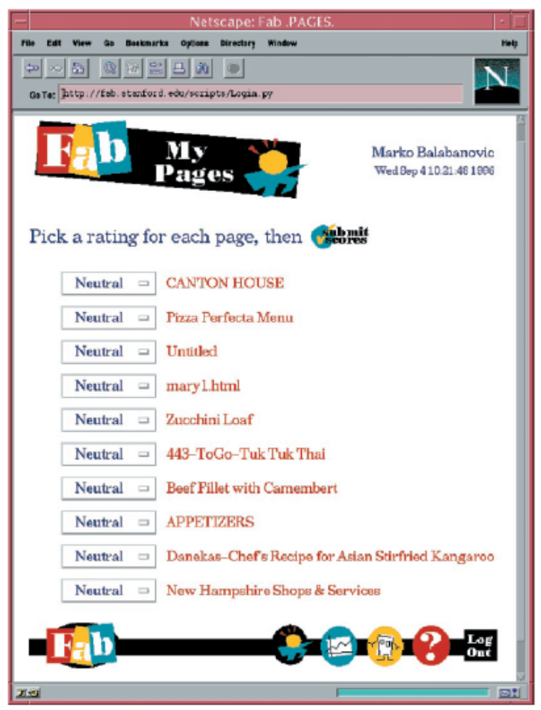
User Feedback
When the user has requested, received, and looked over the recommendations, they are required to assign a rating (7-point scale)
Ratings are stored in the personal agent profile
Ratings are sent to the collection agents for adapting the user profiles (stored by him)
Highly rated pages are sent to similar users (collaborative)

Slide 14
Collection Agents
The construction of accurate profiles is a key task (both for content-based and collaborative-based recommenders)
The collection agents’ profiles represent a topic of interest
The population of collection agents adapts to the population of users (as in a market)
  Unpopular collection agents (whose pages are not seen) or unsuccessful ones (whose pages receive low feedbacks) are removed
This copes with the issue of keeping the profiles up-to-date

Slide 15
Empirical Evaluation (FAB)
11 users – each one interested in one topic
They evaluate (feedback) on documents recommended by the system
Every five sessions the users where shown a special selection used for evaluation purpose
The ranking of the user evaluation was compared with the ranking conjectured by the system
The two ranked list where compared with the ndpm measure

Slide 16
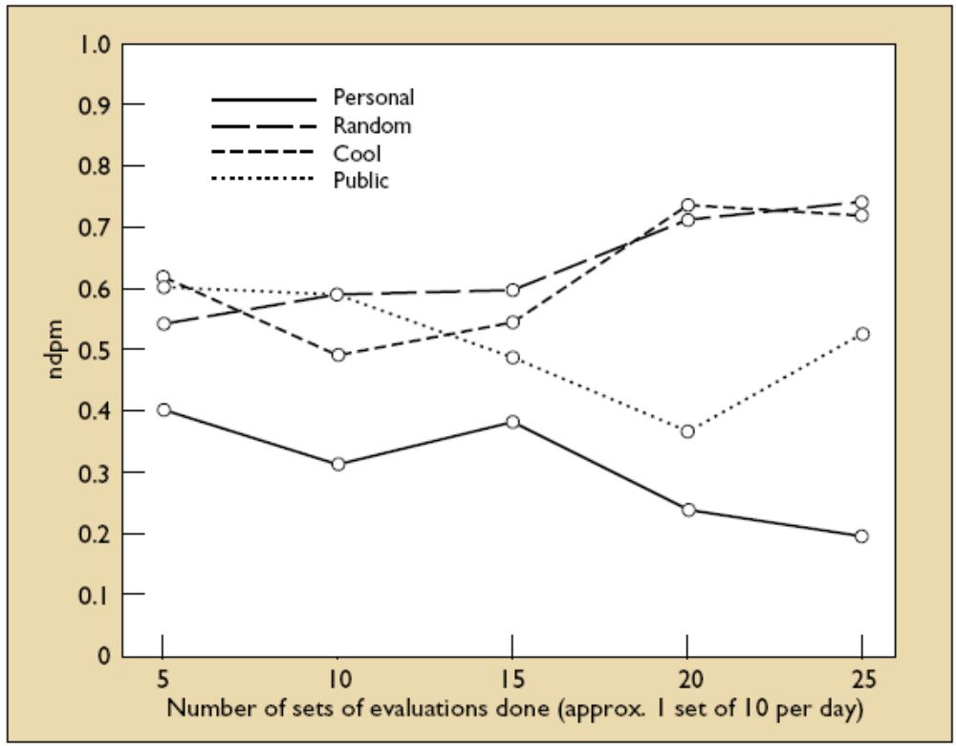
Comparison with other approaches
Personal = FAB personalized recommendations
Random recommendations
Cool = pages recommended by human (cool sites of the day)
Public = best matching an average user profile (i.e. , is a non personalized solution)

Slide 17
Feature Combination
Achieves the content/collaborative merger treating collaborative information (ratings of users) as simply additional feature data associated with each example and use content-based techniques over this augmented data set
[Basu, Hirsh & Cohen 1998] apply the inductive rule learner Ripper to the task of recommending movies using both user ratings and content features
The feature combination hybrid lets the system consider collaborative data without relying on it exclusively, so it reduces the sensitivity of the system to the number of users who have rated an item
The system have information about the inherent similarity of items that are otherwise opaque to a collaborative system.

Slide 18
Feature Combination
Target product
products
Rating to predict
Ratings
users
Target user
Features of the products
Information used to make the prediction
Known Ratings of the target user

Slide 19
Cascade
One recommendation technique is employed first to produce a coarse ranking of candidates and a second technique refines the recommendation from among the candidate set
Example: EntreeC uses its knowledge of restaurants to make recommendations based on the user’s stated interests:
  The recommendations are placed in buckets of equal preference (equal utility)
  and the collaborative technique is employed to break ties
Cascading allows the system to avoid employing the second, lower-priority, technique on items that are already well-differentiated by the first
But requires a meaningful and constant ordering of the techniques.

Slide 20
Feature Augmentation
Produce a rating or classification of an item and that information is then incorporated into the processing of the next recommendation technique
Example: Libra system [Mooney & Roy 1999] makes content-based recommendations of books based on data found in Amazon.com, using a naive Bayes text classifier
In the text data used by the system is included “related authors” and “related titles” information that Amazon generates using its internal collaborative systems
Very similar to the feature combination method:
  Here the output of a recommender system is used for a second RS
  In feature combination the representations used by two systems are combined.

Slide 21
Example- Movie Domain
EachMovie Dataset [Compaq Research Labs]
  Contains user ratings for movies on a 0–5 scale.
  72,916 users (avg. 39 ratings each).
  1,628 movies.
  Sparse user-ratings matrix – (2.6% full).
Crawled Internet Movie Database (IMDb)
  Extracted content for titles in EachMovie.
Basic movie information:
  Title, Director, Cast, Genre, etc.
Popular opinions:
  User comments, Newspaper and Newsgroup reviews, etc.

Slide 22
Content-Boosted Collaborative Filtering
EachMovie
Web Crawler
IMDb
Movie
Content
Database
User Ratings
Matrix (Sparse)
Full User
Ratings Matrix
Content-based
Predictor
Active
User Ratings
Collaborative
Filtering
Recommendations

Slide 23
Content-Boosted CF - I
User-ratings Vector
Training Examples
Content-Based
Predictor
Pseudo User-ratings Vector
User-rated Items
Unrated Items
Items with Predicted Ratings

Slide 24
Content-Boosted CF - II
User Ratings
Matrix
Pseudo User
Ratings Matrix
Content-Based
Predictor
Compute pseudo user ratings matrix
  Full matrix – approximates actual full user ratings matrix
Perform CF
  Using Pearson corr. between pseudo user-rating vectors

Slide 25
Experimental Method
Used subset of EachMovie (7,893 users; 299,997 ratings)
Test set: 10% of the users selected at random.
  Test users that rated at least 40 movies.
  Train on the remainder sets.
Hold-out set: 25% items for each test user.
  Predict rating of each item in the hold-out set.
Compared CBCF to other prediction approaches:
  Pure CF
  Pure Content-based
  Naïve hybrid (averages CF and content-based predictions)

Slide 26
Metrics
Mean Absolute Error (MAE)
  Compares numerical predictions with user ratings
ROC sensitivity [Herlocker 99]
  How well predictions help users select high-quality items
  Ratings ≥ 4 considered “good”; < 4 considered “bad”
Paired t-test for statistical significance

Slide 27
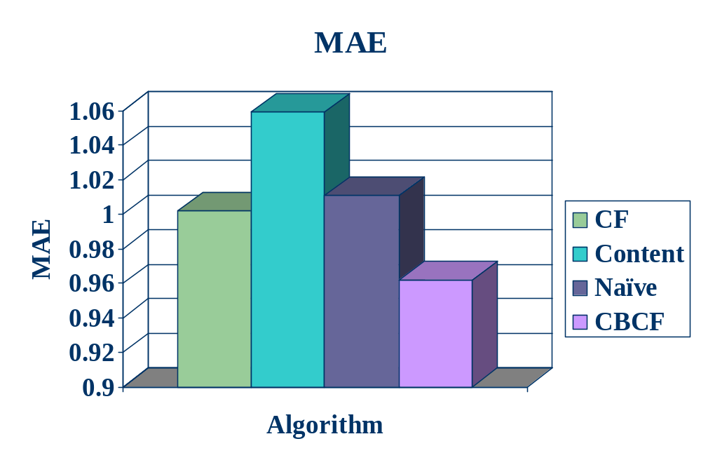
Results - I
CBCF is significantly better (4% over CF) at (p < 0.001)

Slide 28
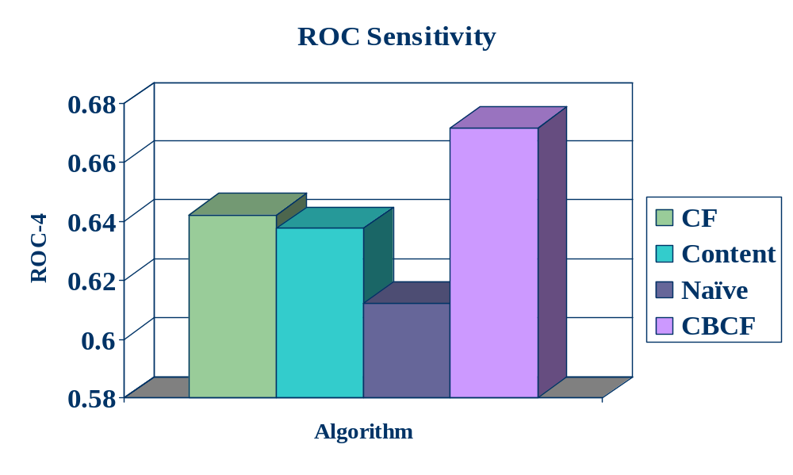
Results - II
CBCF outperforms rest (5% improvement over CF)

Slide 29
Meta-level
Using the model generated by one as the input for another
Example: [Pazzani 1999] collaboration via content: the model generated by the content-based approach (winnow) is used for representing the users in a collaborative filtering approach.

Slide 30
Collaboration via Content
Problem addressed: in a collaborative-based recommender, products co-rated by a pair of users may be very few – correlation between two users is not reliable
In collaboration via content a content-based profile of each user is exploited to detect similarities among users
Main problems to solve are:
  How to build a content-based profile of each user?
  What kind of knowledge must be used?
  How to measure user-to-user similarity?
[Pazzani, 1999]

Slide 31
A Bidimensional Model
item
user
user
ratings
User features
Product features
User features have always a good overlap and similarity computation is more reliable.

Slide 32
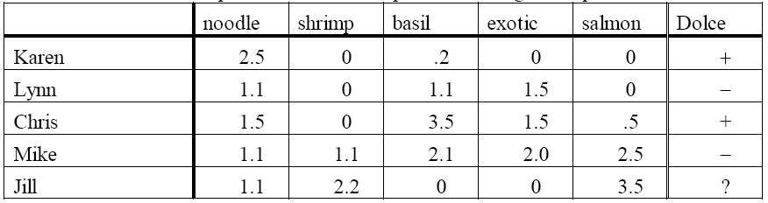
Content-Based Profiles
The weights can be the average of the TF-IDF vectors of the documents that are highly rated by the user (as in FAB or in Syskill & Webert)
  E.g. in the restaurants liked by Karen the word “noodle” is very frequent (and not much frequent in the entire collection of restaurant descriptions)
Or you can use winnow as in [Pazzani, 1999], to learn the user model (see next slide…).

Slide 33
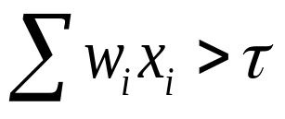
Winnow (learning a user model)
Each word considered in the profiles is considered as a Boolean feature (present/not present)
Winnowing learns a weight w_{i} associated to each word x_{i}
Initially all the weights are set to 1. Then, for each document rated by the user a linear threshold function is computed
If the above sum is over the threshold and the user did not liked the document, then the weights associated with each word in the document are divided by 2
If the sum is below the threshold and the user liked the document then all weights associated with words in the document are multiplied by 2
Otherwise no change is made
The set of training examples is cycled through adjusting the weights until all examples are processed correctly and no changes are made to the weights.
[Pazzani, 1999]

Slide 34
Winnow in the general case
The Winnow algorithm takes as input an initial vector w=(w₁, …, w_{n}), a promotion factor α, and a threshold τ
The algorithm requires that:
  w is positive (i.e., each coordinate of w is positive)
  α > 1 (previous slide α = 2)
  τ > 0
Winnow proceeds in a series of trials and predicts in each trial according to the threshold function (inner product) w·x > τ
If the prediction is correct, then no update is performed; otherwise the weights are updated as follows:
  On false positive (erroneously above the threshold), for all i, w_{i} ← α^{−xi}w_{i}
  On false negative (erroneously below the threshold), for all i, w_{i} ← α^{xi}w_{i}

Slide 35
Content-Based
They have built a content-based recommender using
  The ratings of a user on a set of restaurants
  The user profile is built using the winnow technique
  The recommendation for a new restaurant is based on the threshold function
    If the inner product of the user model multiplied by the Boolean vector of the restaurant is above the threshold → prediction is +
    Otherwise the prediction is -

Slide 36
Collaborative-Based
They have built two collaborative based systems
Standard collaborative filtering using Pearson correlation
Collaboration via Content
  For each user the profile is built as for the content-based recommender system
  Winnow used for learning the feature weights for each feature (e.g., noodles, shrimps, basil, salmon, etc.)
  Similarity between two users is performed using Pearson on the two profiles.

Slide 37
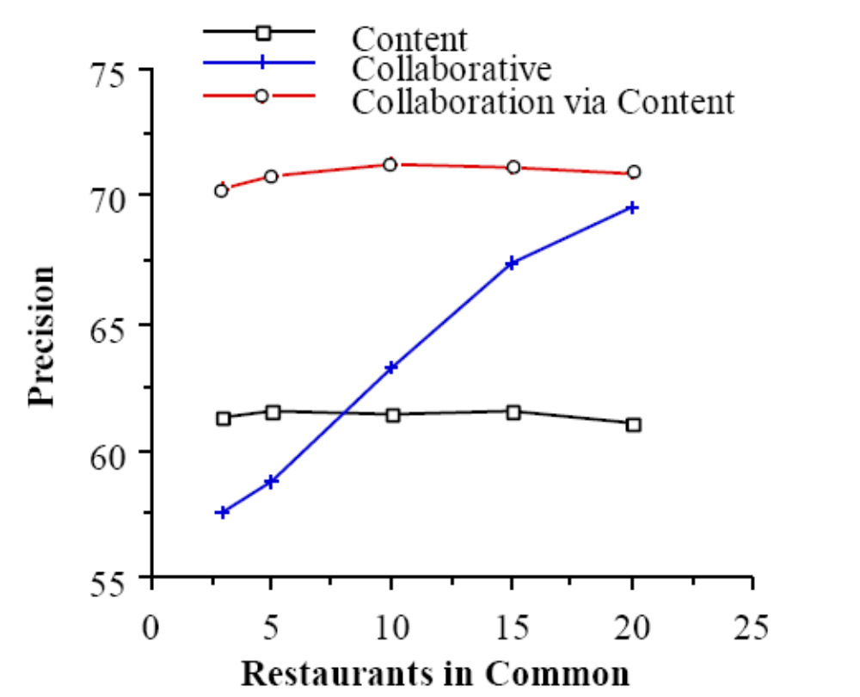
Comparison
Content–based recommendation is done with winnow
Collaborative is standard using Pearson correlation
Collaboration via content uses the content-based user profiles built by winnow.
Averaged on 44 users
Precision is computed in the top 3 recommendations = (# of plus in the recommendation list)/3

Slide 38
Details
There are 58 restaurants divided in two groups S and N, and 44 users
The target-user training data are always 30 restaurants
The other users data are only from the set S
They make prediction only for restaurants in S
They varied (from 3 to 20) the restaurants used to build the target user profile coming from the set S:
  (3S, 27N), (5S, 25N), (10S, 20N), (15S, 15N), (20S, 10N)

Slide 39
Discussion
Collaboration via content is attractive because
  You do not to have to collect experiences (ratings) of the users on common products
  It may be applicable to recommend products in a product category even if the user has not rated any product in that category but there are some other ratings that enable to generate a user model (the weights of the user features)
  The user profile is built using ratings, but provided that you have some ratings in a domain, you can build a “useful” user model
  It could be used to bootstrap a collaborative filtering system (when not enough ratings are available).

Slide 40
Summary
Hybrid methods are the most powerful and popular right now – there are plenty of options for hybridization
We mostly described content-based and collaborative-based hybrids – but you may build hybrid systems combining any kind of RS
The most simple and largely used methods are the weighted, switched, and mixed approaches
FAB and collaboration via content are Meta-level approaches
  building the user model with knowledge derived from an analysis of the content liked by the user is very powerful.

Slide 41
Questions
What are the pros and cons of different hybridization approaches?
What is the user profile in a collaboration via content approach?
Can collaboration via content be applied for catalogues containing multiple types of products (e.g., dig. cameras and movies)?
How it is structured the product model and the user model in a content-based filtering system based on winnow?
In the “weighted” approach, how the weights could be determined?
What are the similarities between the “feature combination” approach and item-to-item collaborative filtering?

